Slide 1

COURSE: B.Sc. (PROGRAMME) IN ECONOMICS
PAPER NAME – MICROECONOMICS II
TOPIC – PRICE DISCRIMINATION UNDER MONOPOLY
YEAR- THIRD SEMESTER-5 SESSION -2022-2023
DATE OF LECTURE: 23/08/2022
PREPARED BY
DR. KAMALIKA CHAKRABORTY
ASSISTANT PROFESSOR (DEPARTMENT OF ECONOMICS)
KHATRA ADIBASI MAHAVIDYALAYA, BANKURA, WEST BENGAL

Slide 2
Price discrimination and its types
Monopoly is a market where there is a single seller of a product called monopolist. The monopolist has control over pricing, demand, and supply decisions He, thus, sets prices in a way, so that maximum profit can be earned.
The monopolist often charges different prices from different consumers for the same product. This practice of charging different prices for identical product is called price discrimination.
There are three types of price discrimination

Slide 3
Types of Price discrimination (contd.)
i. Personal:
This is a type of price discrimination where different prices are charged from different individuals according to the level of income of consumers as well as their willingness to purchase a product. For example, a doctor charges different fees from poor and rich patients.
ii. Geographical:
Geographical price discrimination takes place when the monopolist charges different prices at different places for the same product. This type of discrimination is also called dumping.
iii. On the basis of use:
This happens when different prices are charged according to the use of a product. For instance, an electricity supply board charges lower rates for domestic consumption of electricity and higher rates for commercial consumption.

Slide 4
Degrees of Price discrimination
Degrees of Price discrimination may be classified into 3 categories:
i. First-degree Price Discrimination:
Refers to a price discrimination in which a monopolist charges the maximum price that each buyer is willing to pay. This is also known as perfect price discrimination as it involves maximum exploitation of consumers. In this, consumers fail to enjoy any consumer surplus. First degree price discrimination is practiced by lawyers and doctors.
ii. Second-degree Price Discrimination:
Refers to a price discrimination in which buyers are divided into different groups and different prices are charged from these groups depending upon what they are willing to pay. Railways and airlines practice this type of price discrimination.
iii. Third-degree Price Discrimination:
Refers to a price discrimination in which the monopolist divides the entire market into submarkets and different prices are charged in each submarket. Therefore, third-degree price discrimination is also termed as market segmentation.
In this type of price discrimination, the monopolist needs to segment market in a manner, so that there is no possibility of resale of products sold in one market in another market. Moreover, he/she should identify the price elasticity of demand of different submarkets. The groups are divided according to age, sex, and location. For instance, railways charge lower fares from senior citizens. Students get discount/concessions in cinema tickets and tickets for visiting museums, and historical monuments.

Slide 5
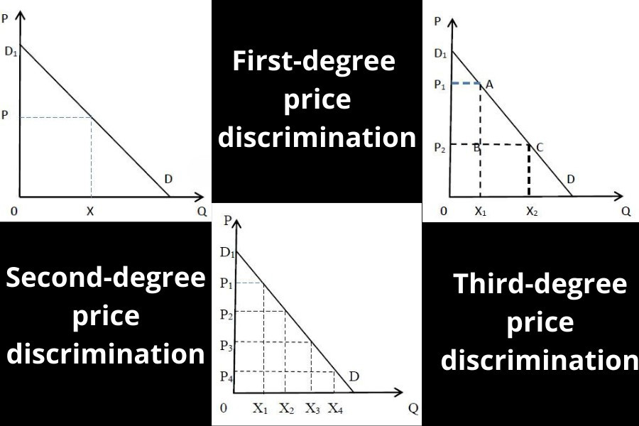
Degrees of Price discrimination(contd.)

Slide 6
Conditions for successful Price discrimination(contd.)
Buyers from the low-priced Price discrimination is possible under the following conditions:
Control of the seller over the supply of his product.
The seller should be able to divide the market into at least two sub-markets (or more).
The price-elasticity of the product must be different in different markets. The monopolist charges a high price for those buyers whose price-elasticity of demand is low and lower price for the buyers whose price elasticity of demand is high.
No resale of goods should take place from low price market to high price market.

Slide 7
References
https://www.economicsdiscussion.net/monopoly/price-discrimination-under-monopoly-types-degrees-and-other-details/3741
https://econtips.com/monopoly-price-discrimination/
https://www.toppr.com/guides/business-economics/determination-of-prices/price-discrimination/

Slide 8
THANK YOU

